Slide 1


Indicators for climate sensitivity studies
Mónika Lakatos, lakatos.m@met.hu, OMSZ
KRITéR Zárórendezvény, OMSZ, 2015. december 8.

Slide 2
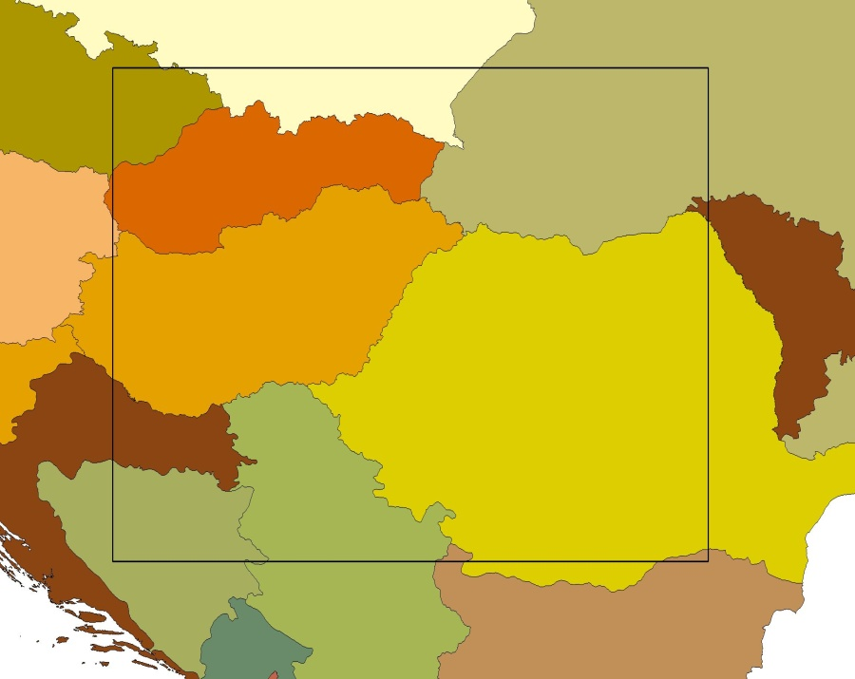
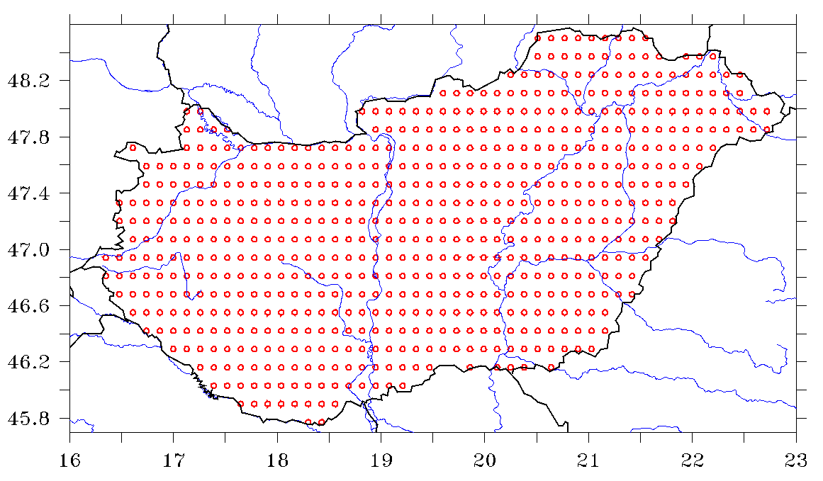
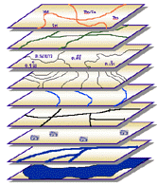
Climate observations in the
National Adaptation Geo-information System (NAGIS)
Homogenized, interpolated data, CarpatClim methods: MASH-MISH
1961–2010, daily, ~10 km spatial resolution, 1104 grid point data for Hungary
Area out of CarpatClim
nater.mfgi.hu
Notes:
Az éghajlatváltozás
hatásaival szembeni ellenállás
Növelése
tudományos alapokon nyugvó
információs rendszer amely:
alapot biztosít különböző szintű
adaptációs stratégiák kidolgozásához és
elősegiti az adaptációval kapcsolatos
döntéshozatalt és intézményi hálózat
Működését

Slide 3
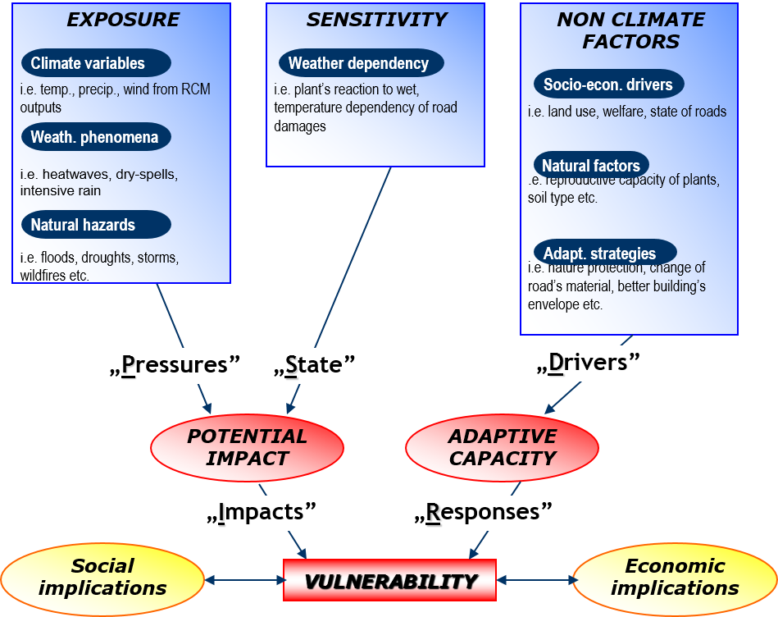
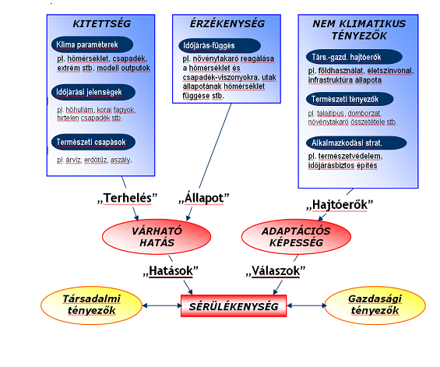
Vulnerability assessment scheme
observations
megfigyelések
Pálvölgyi, T. and Hunyady, A., 2008.

Slide 4
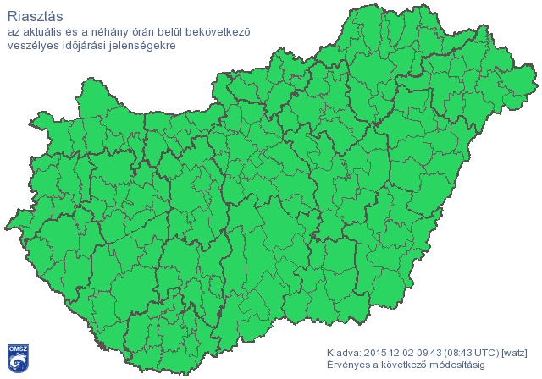
WP3: Heatwave-induced excess mortality
Period 2005-2014
Daily average temperatures
  Grid point average for districts (175)
  Median of the grid point values situated in the specific district (175)

Slide 5
WP4: Impact and vulnerability assessment of road accidents within extreme weather events
During heatwave periods
Wintertime periods with precipitation
  Summer half year: 1 April – 30 September
  Winter half year: 1 October- 31 March
Dates of hot days, Tmax >= 30 °C, 2011-2014, in each grid point
Dates of prec5 days, daily prec >= 5mm, 2011-2014, winter half year, in each grid point

Slide 6

WP5: Effects of climate conditions on tourism TCI, mTCI, CIT
Daily, 1961-2010, 1104 grid point
Daily maximum temperature, daily minimum temperature, mean cloud cover, precipitation sum, mean relative humidity, minimum relative humidity, sunshine duration, wind speed (10m)
relhumMin=100 $\frac{e}{eSatTmax}$
UK Climate Projections NATIONAL CASE STUDY, What could tomorrow’s weather and climate look like for tourism in the South West of England?

Slide 7
Thank you for your attention!

