Slide 1
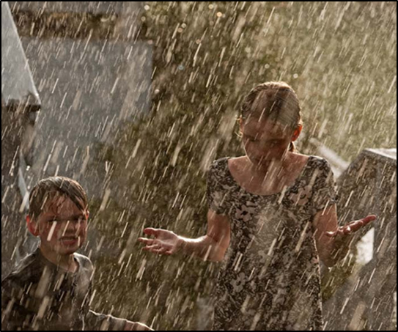
Preparing for a future climate:
Tailored climate products disseminated through
The Norwegian Centre for Climate Services
Eirik J. Førland, Norwegian Meteorological Institute, Oslo, Norway
KRIT’eR Workshop, Budapest, 8. December, 2015
Norwegian Centre for Climate Services (NCCS)

Slide 2


Norwegian Centre for Climate Services
A cooperation between
MET Norway
Norwegian Water Resources and Energy
Directorate (NVE)
Uni Research (Univ. in Bergen)
Main task: Provide decision makers in Norway with information relevant for climate adaptation
Norsk klimaservicesenter

Slide 3
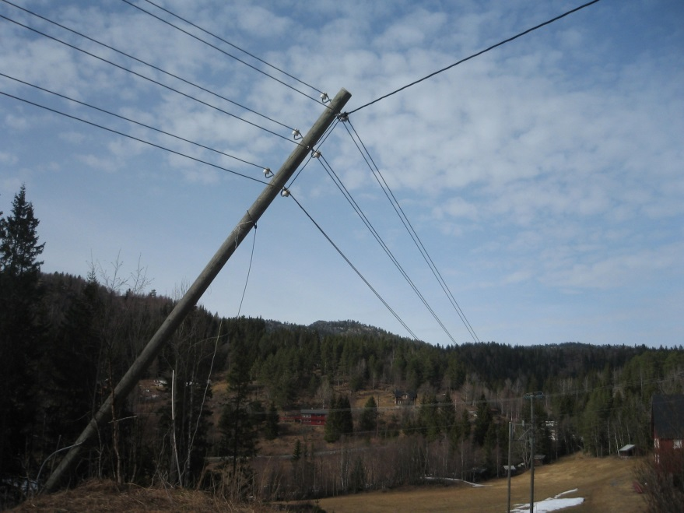
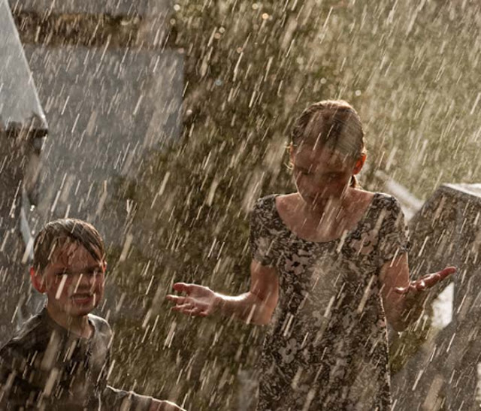
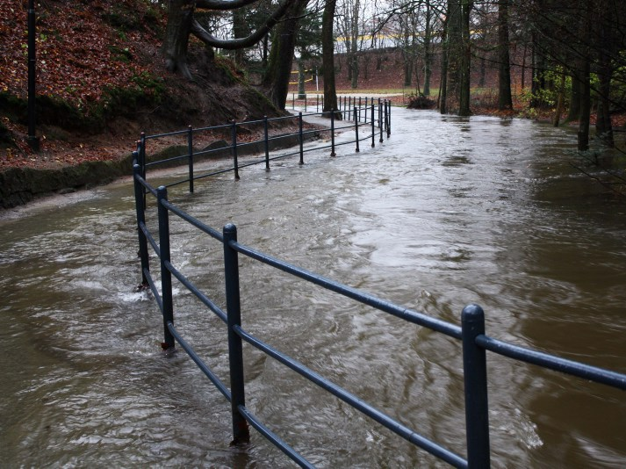
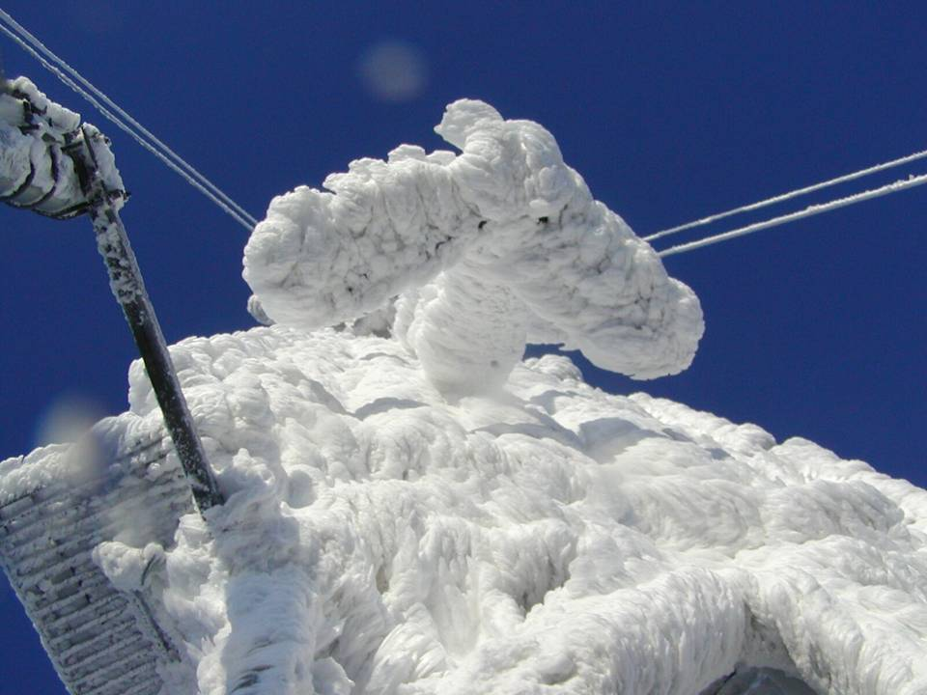
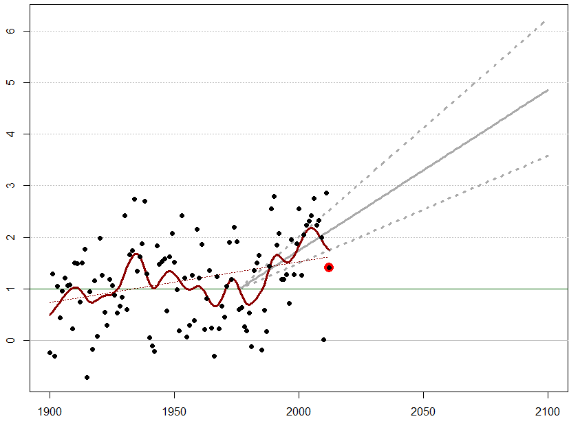
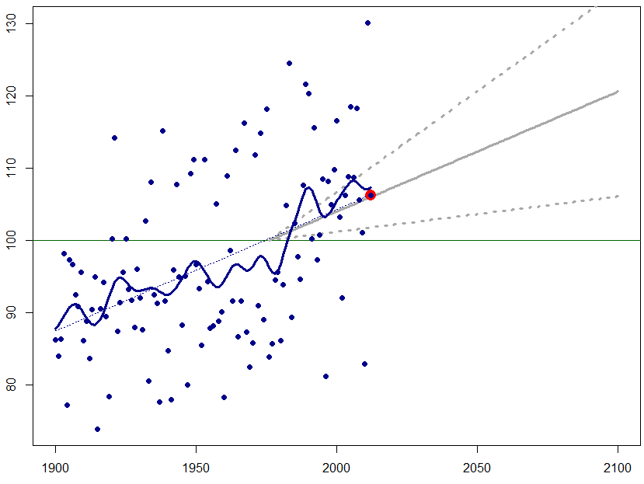
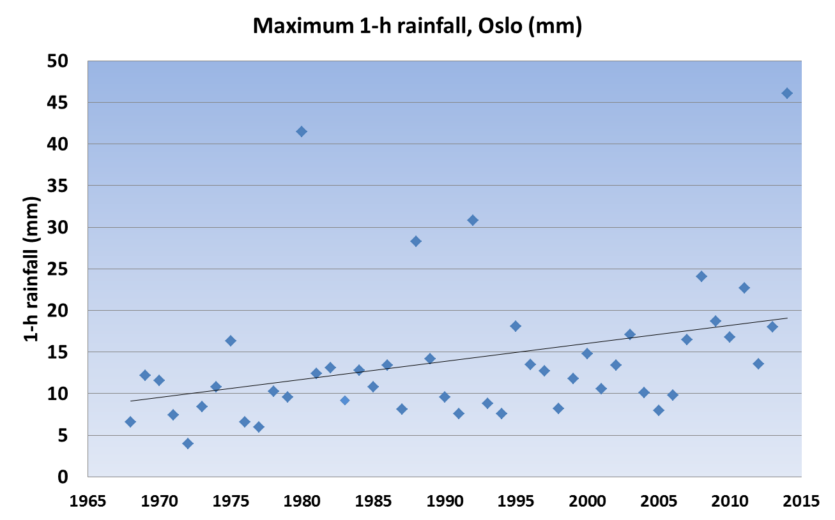
MET and NVE have “always” been serving authorities design values …
So what’s new with Climate Services?
Temperature in Norway, ºC
Precipitation in Norway
Annual max of 1 h rainfall, Oslo
Norsk klimaservicesenter

Slide 4
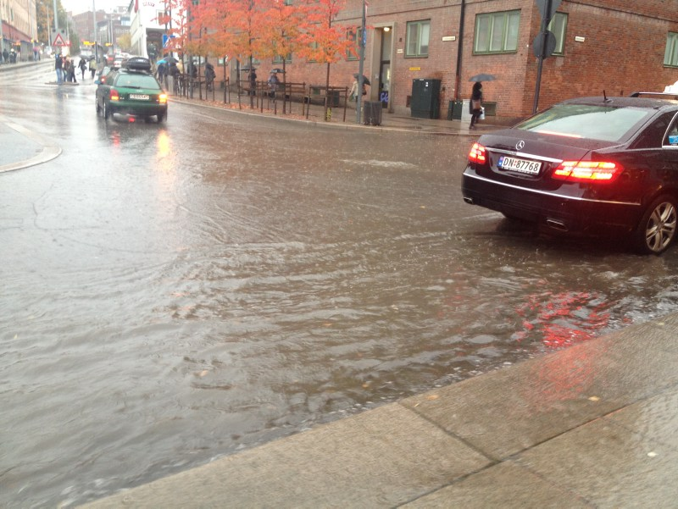
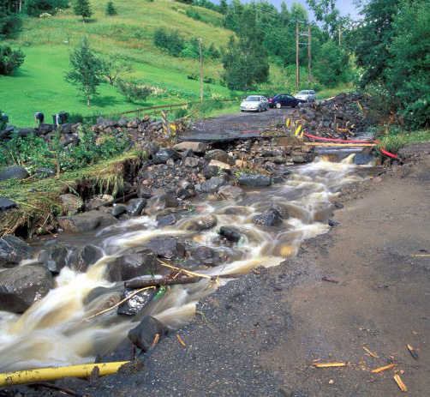
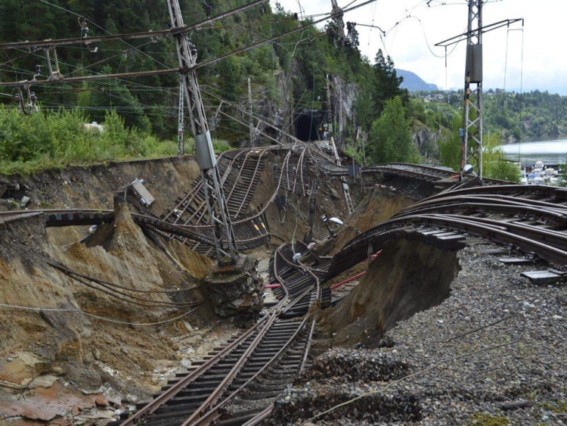
… We need to plan for future climate;- but in some ways we are not even adapted to present climate……!
Norsk klimaservicesenter

Slide 5
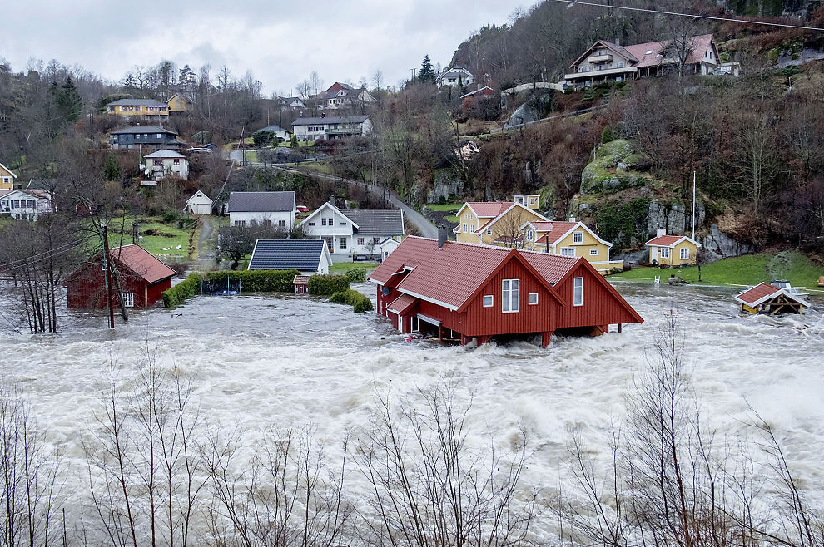
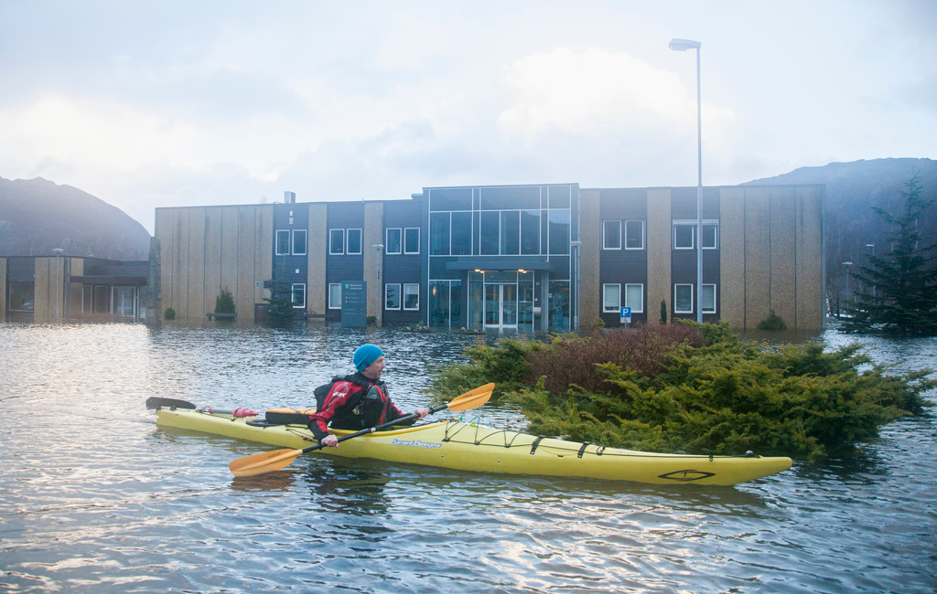
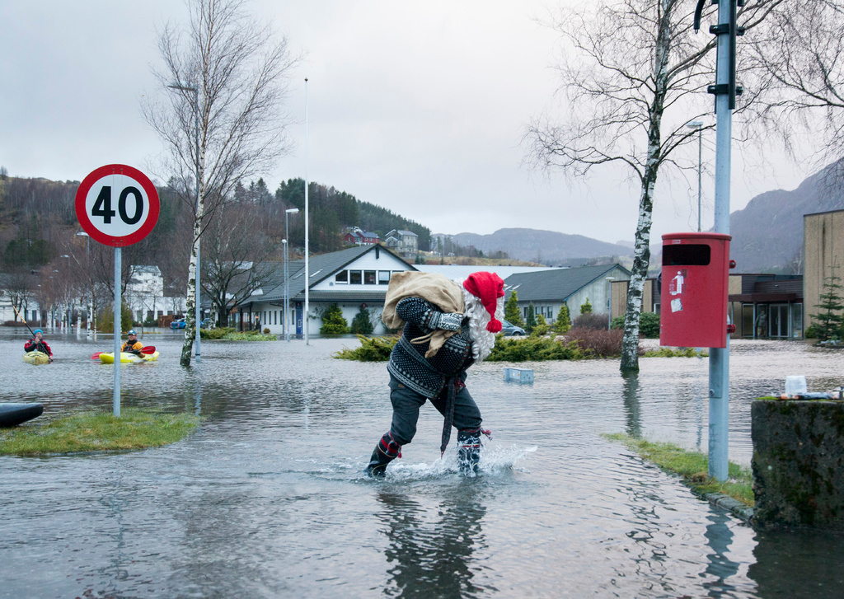
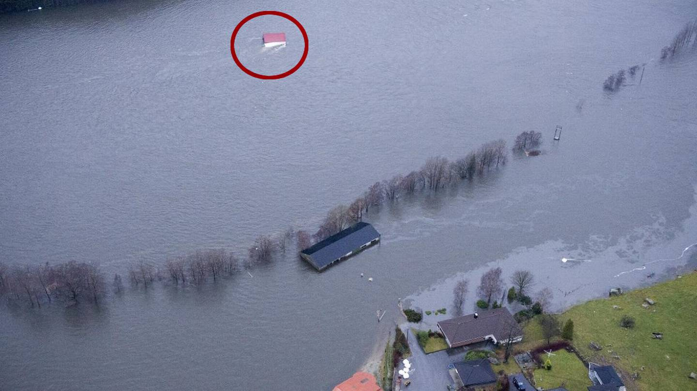
SW-NORWAY 6.DEC 2015
Norsk klimaservicesenter

Slide 6
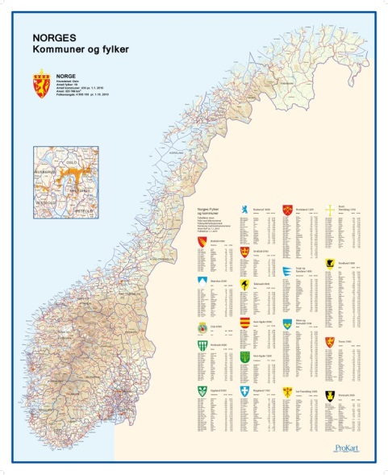

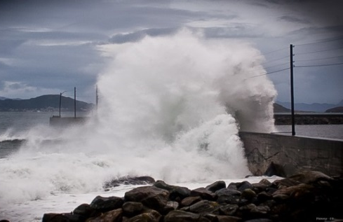
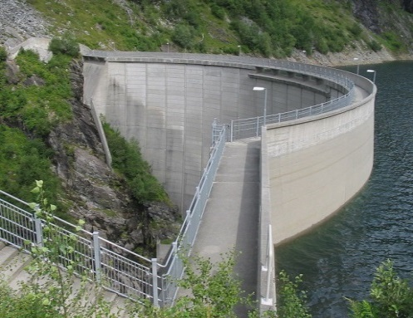
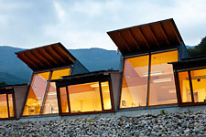

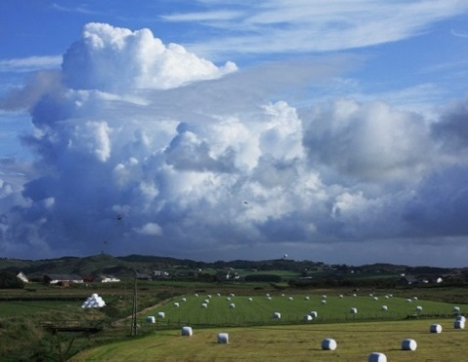
Important user categories - 1:
Governmental institutions and authorities:
  National to municipality level
  Roads, railways, coastal infrastructure etc.
Sectors/Industries, e.g.:
  Energy
  Buildings
  Health
  Primary industries
Norsk klimaservicesenter

Slide 7


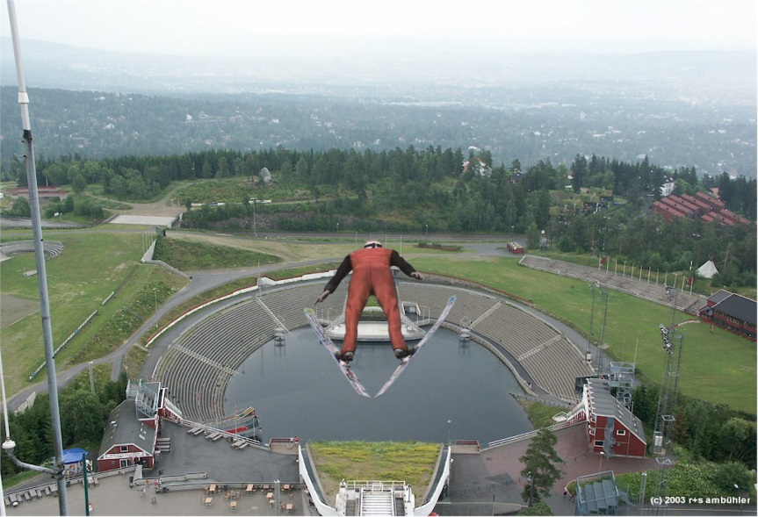
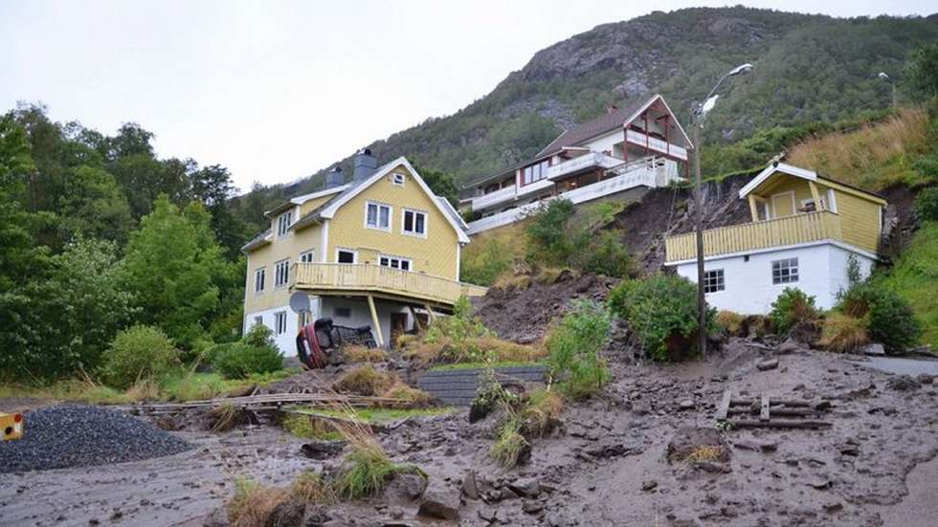
Important user categories - 2:
Climate impact research
  Physical nature
  Ecosystems
  Society
Norsk klimaservicesenter

Slide 8
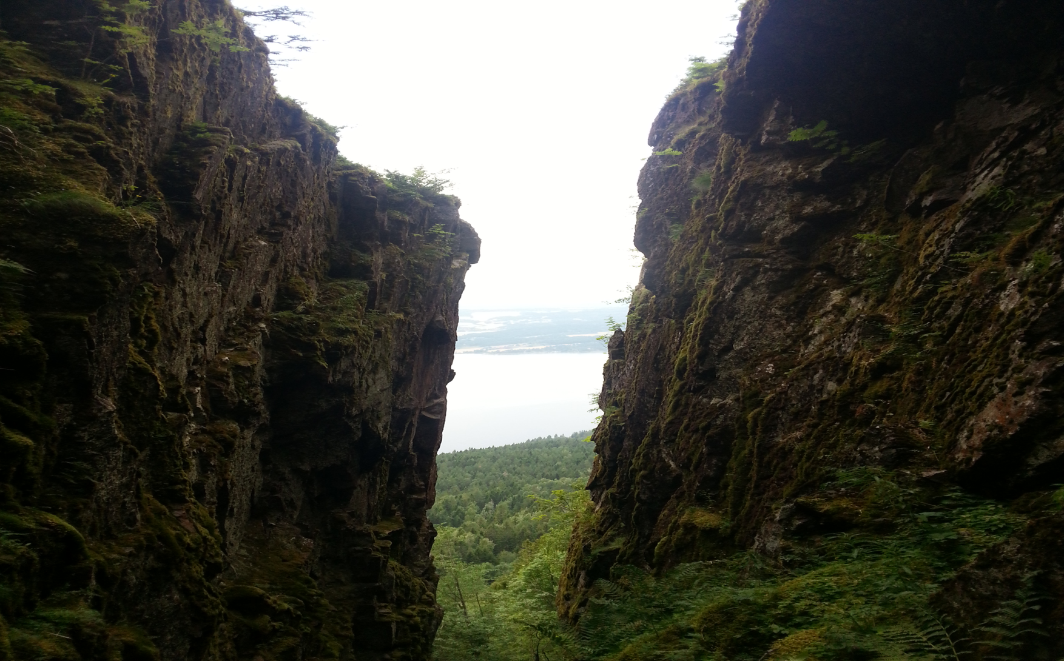

Knowledge gap 1
Decision makers’
information needs
Climatologists’ knowledge
Norsk klimaservicesenter

Slide 9
What do the users need ???
Temperature?
Snow? Rain? Wind?
Freezing degree days?
Growing season?
Droughts?
Variables/ indices ?
Time horizon ?
Scales (time and space) ?
Uncertainty
20 yrs?
50 yrs? 100 yrs?
Regional values?
Local values?
Monthly?
Daily? Hourly?
Return periods? Climatology?
“one number”?
“probability distribution”?
“high/low”?
Norsk klimaservicesenter

Slide 10
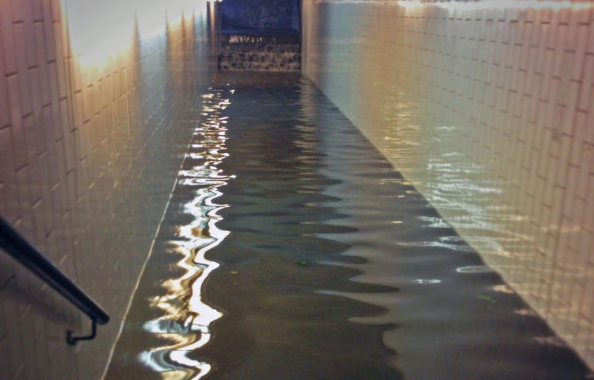
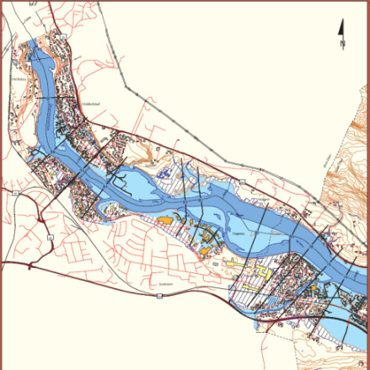
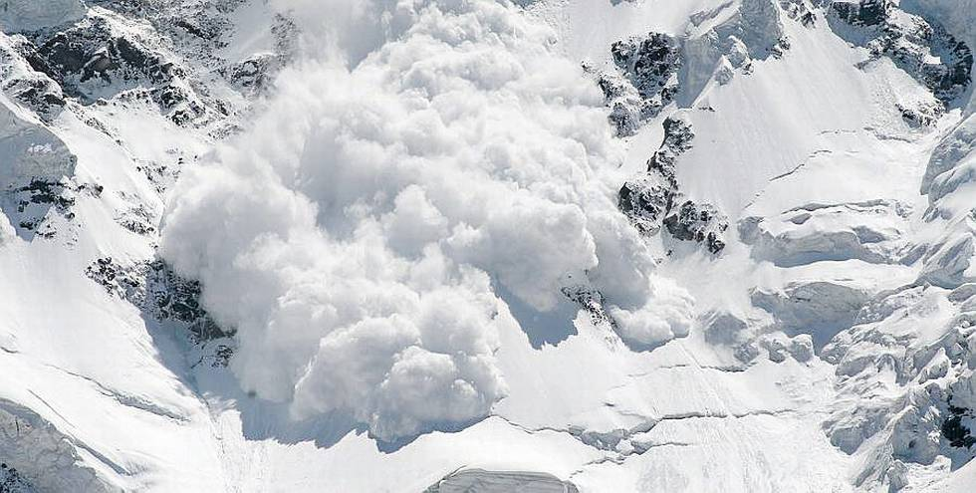


Different users/different needs:
The engineer needs “one number”: A design value to avoid this →
The municipality planner needs a map showing how close to a river to allow e.g. dwelling areas
The impact researcher may need detailed and consistent climate projections of a number of variables or indices…
Norsk klimaservicesenter

Slide 11
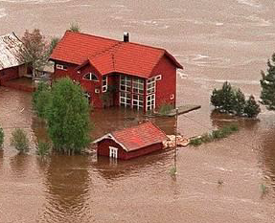
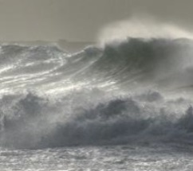

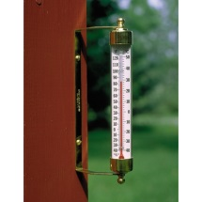

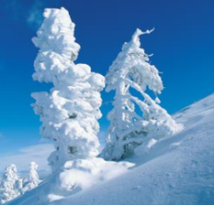
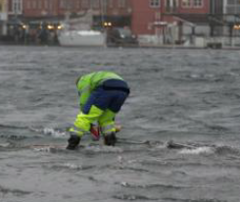


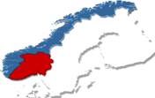

Some results are more uncertain than others
Variables:
Spatial scale:
Time scale:
Year
Season
Day
Hour
Norsk klimaservicesenter

Slide 12



Communication with key users is crucial!
Meetings/seminars with “homogeneous” user groups
Working together in projects to define the needs
…and tailor products
Norsk klimaservicesenter

Slide 13

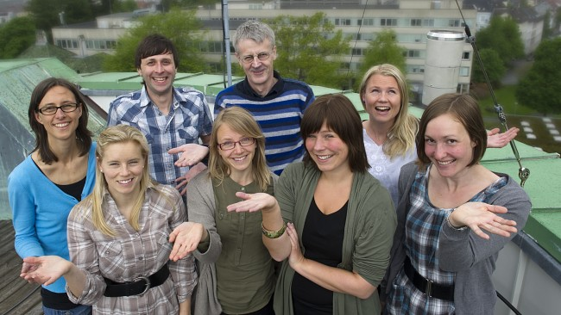
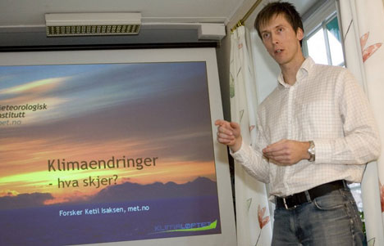
Communication with users
  “The Climate Watch”: A three-level phone and e-mail service
  Seminars/ meetings focused on specific user groups
  NCCS web-site:
klima@met.no
http://kimaservicesenter.no/
Norsk klimaservicesenter

Slide 14
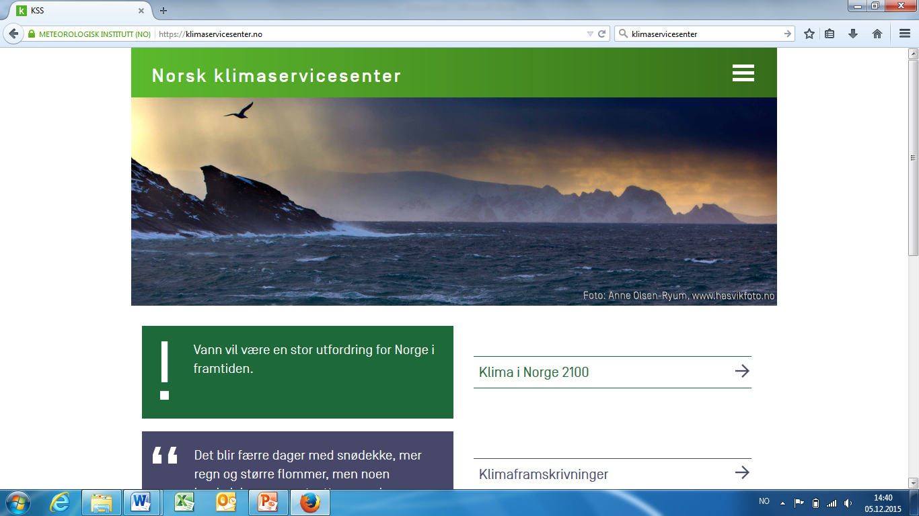
Web-site:www.klimaservicesenter.no
Norsk klimaservicesenter

Slide 15
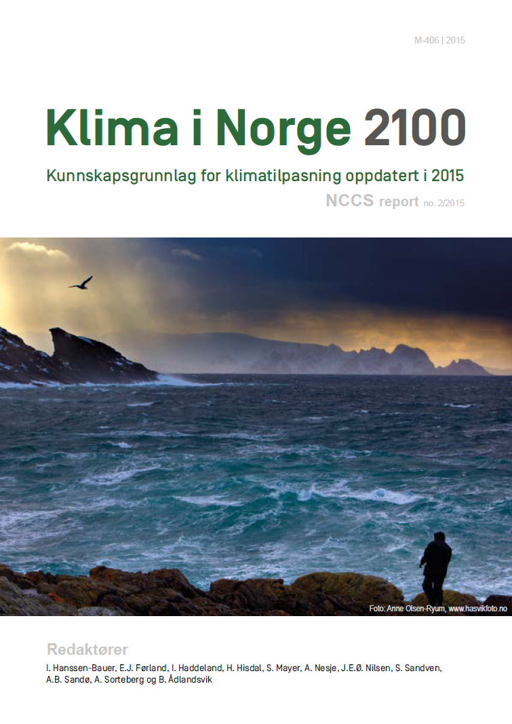

Norsk klimaservicesenter

Slide 16
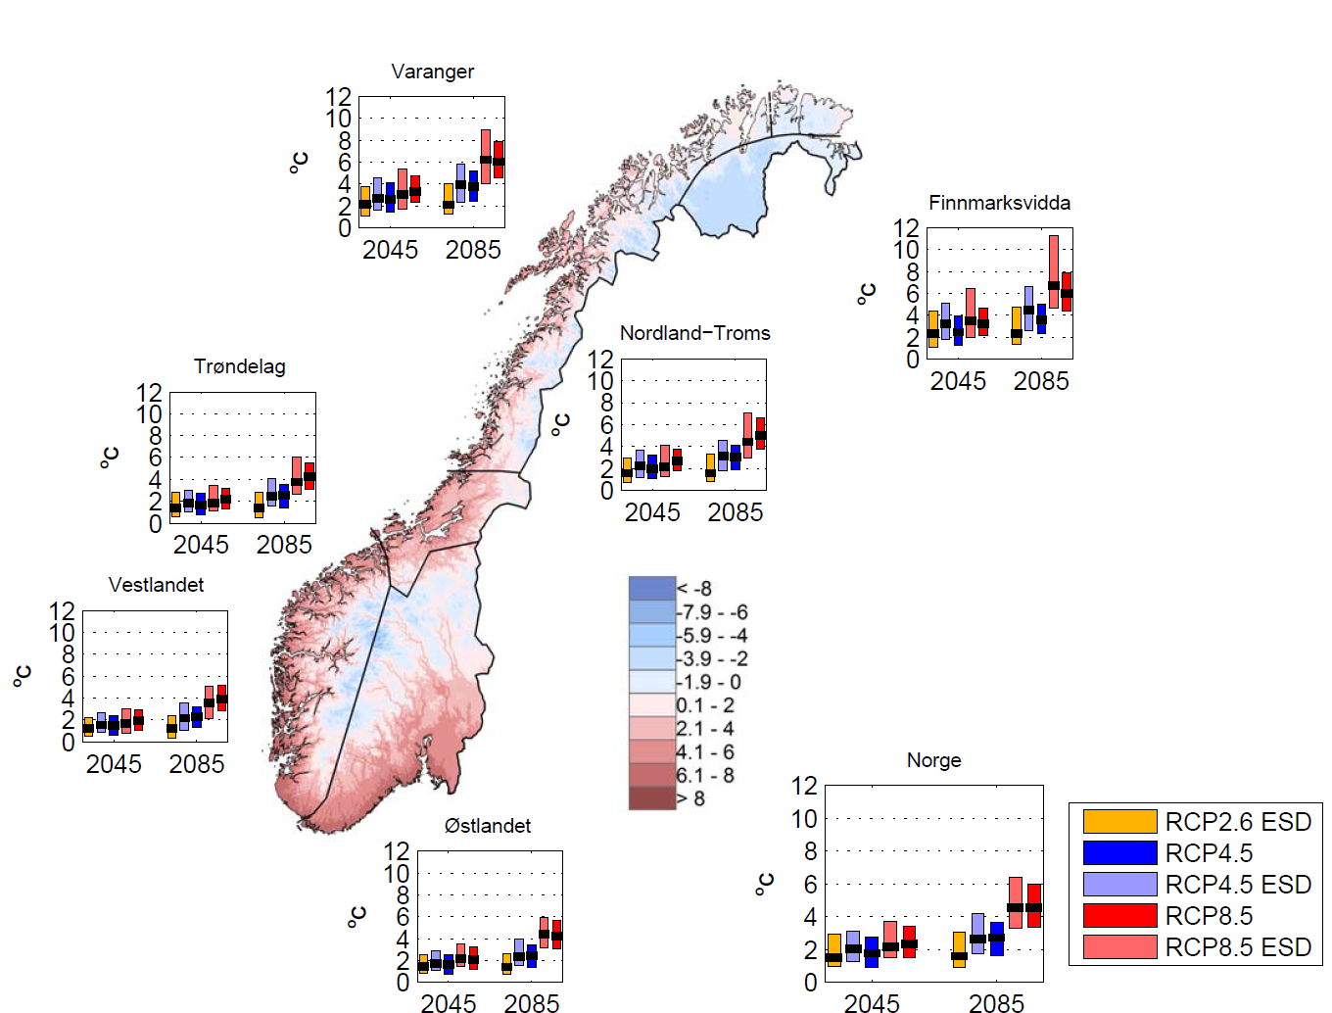
Largest temperature increase in the north
Norsk klimaservicesenter

Slide 17
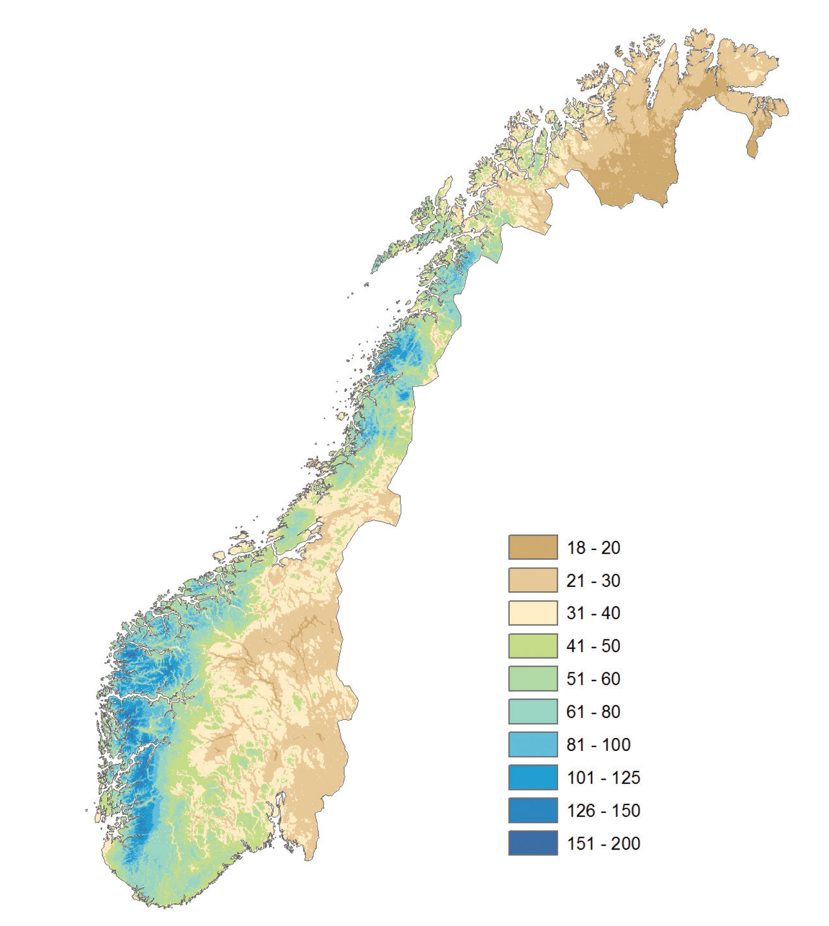
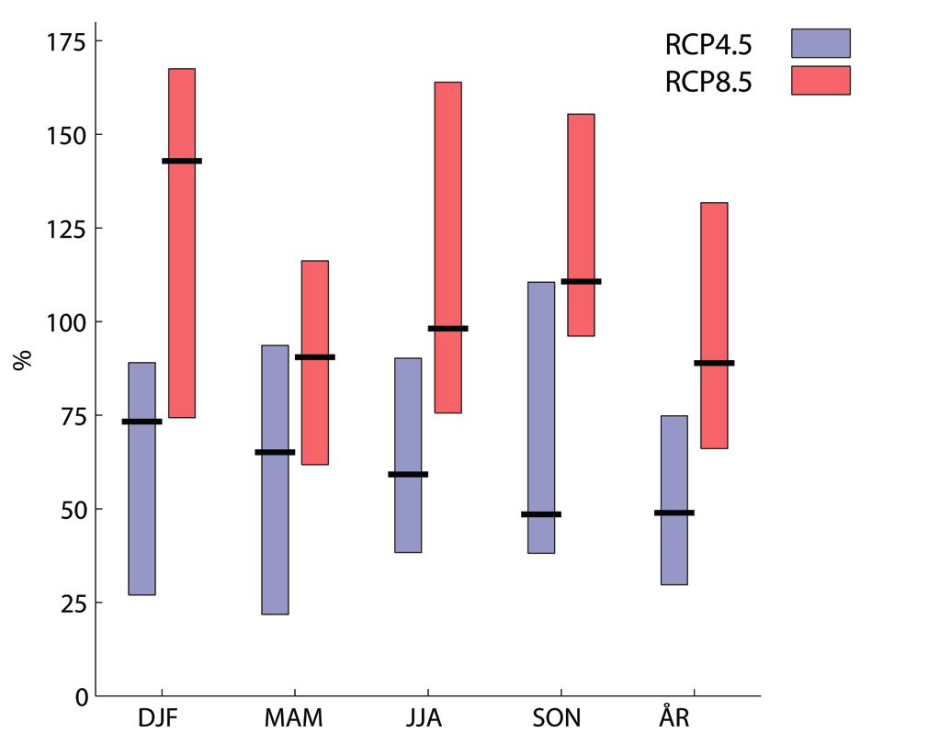
Increase in number of days with heavy rainfall (q99,5)
scenario
Present values (mm/day)
RCP8.5
RCP4.5
+ 150 %
+ 100 %
[mmday]
20-40
40-80
+ 50 %
80-200
DJF
MAM
JJA
SON
YEAR
Norsk klimaservicesenter

Slide 18
More water in rivers during winter season – reduced streamflow during summer
Winter
Summer
Norsk klimaservicesenter

Slide 19
Sea level rise up to 2100 (RCP8.5)
meter
Change in sea level
Stavanger
meter
Oslo
m/
100 yrs
Norsk klimaservicesenter

Slide 20
Tailored «Climate profiles» for each county
Extreme rainfall
Strong winds
Rain floods
Snowmelt floods
Drought
Slides
Avalanches
Storm surges
Norsk klimaservicesenter

Slide 21
KRIGiS: Vulnerability / Impact Studies with a focus on:
Tourism
Critical Infrastructures
Norsk klimaservicesenter

Slide 22
TOURISM
Førland et al., 2012: Cool weather tourism under global warming: Comparing Arctic summer tourists’ weather preferences with regional climate statistics and projections. Tourism Management, 2012
Norsk klimaservicesenter

Slide 23
Responders characteristics (N~1000)
Gender
Educational level
Age
Country of residence
First visit?
Planned / undertaken activities:
(sightseeing/hiking/fishing/whalewatching)
Various temp, indicators (Mean, cold-mild-warm days)
Various rainfall indicators (total, wet day, heavy rainfall)
Cloudiness (Overcast / sunny days)
Days with reduced visibility (fog / drizzle)
Nights with midnigth sun!
Norsk klimaservicesenter

Slide 24
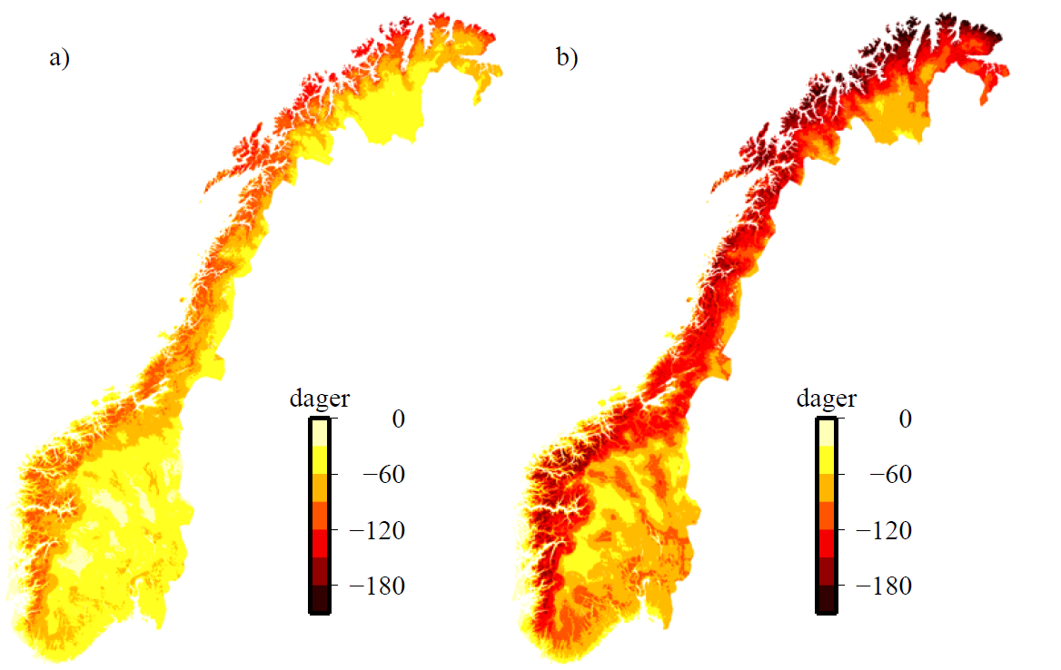
Snow season will be shorter
Changes (number of days) from 1971-2000 to 2071-2100
RCP4.5
RCP8.5
Norsk klimaservicesenter

Slide 25
Changes in «Hot summer days»
Mean number of days per year with daily mean temperature > 20 °C
Scenario period 2071–2100
RCP4.5
RCP8.5
Reference period
1971–2000
Norsk klimaservicesenter

Slide 26
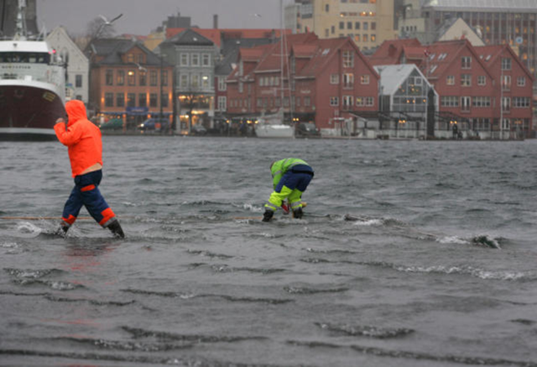
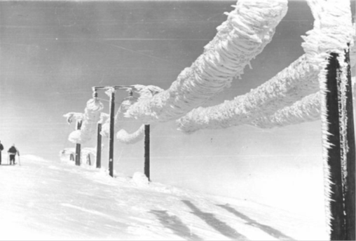
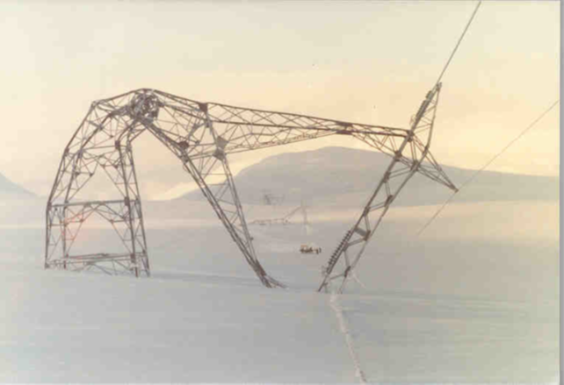
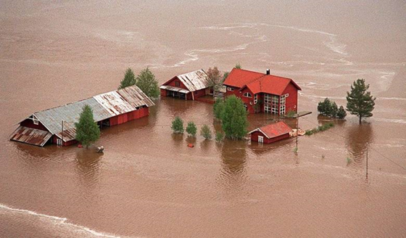
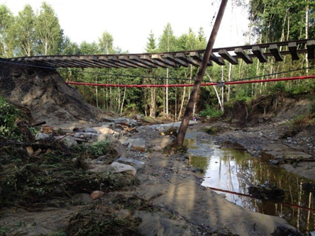
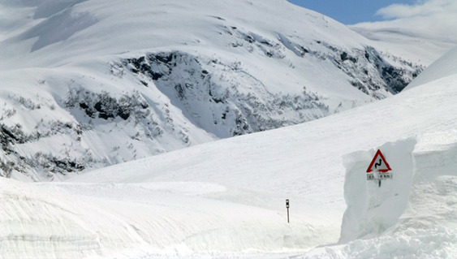
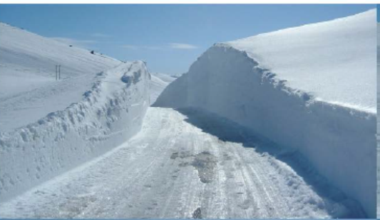
CRITICAL INFRASTRUCTURES
Norsk klimaservicesenter

Slide 27
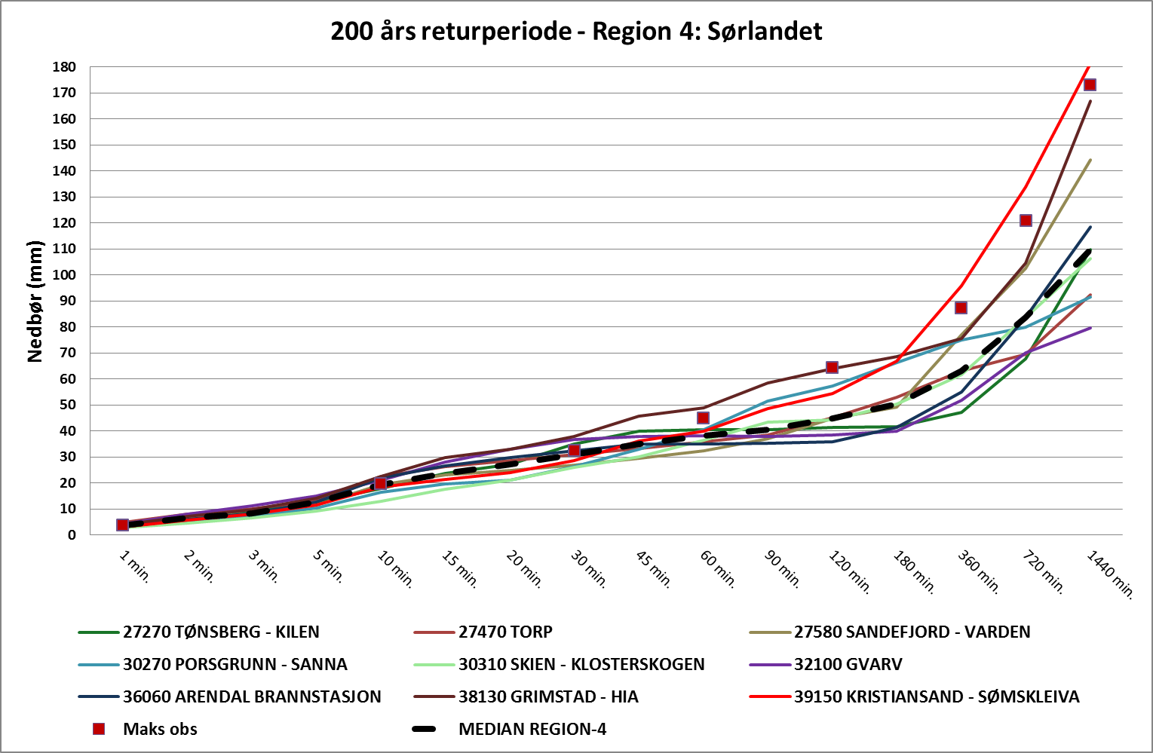
Design values for heavy rainfall
(IDF = Intensity – Duration - Frequency)
IDF-Regions
IDF-values for return period T=200 years for region 4 «Sørlandet»
Norsk klimaservicesenter

Slide 28
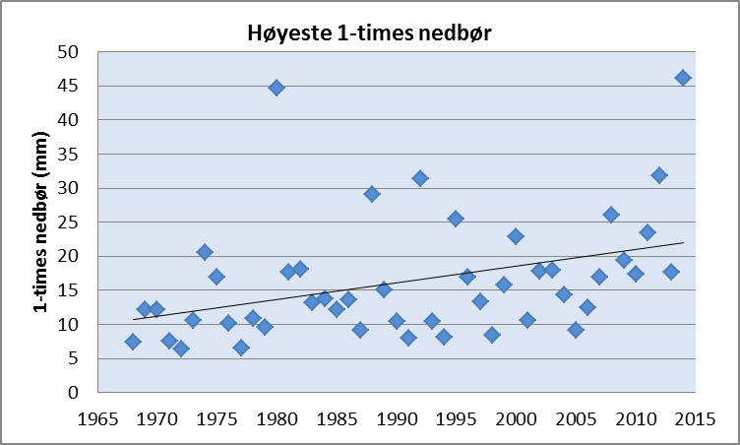
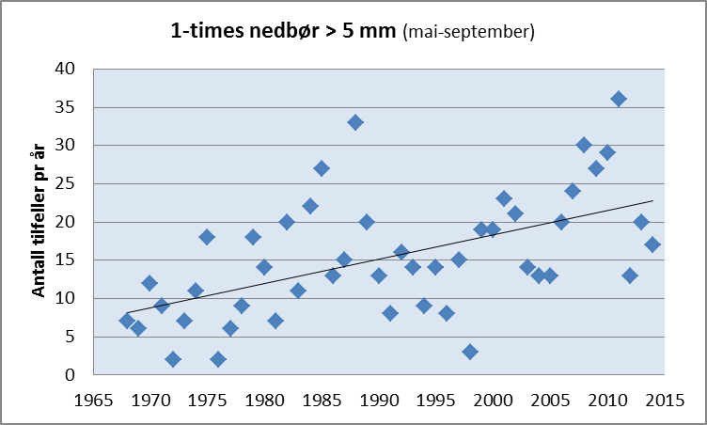
1-hour rainfall Oslo-Blindern 1968-2014
Norsk klimaservicesenter

Slide 29
Trends in short-term rainfall 1968-2014*
Red: Positive trend, Blue: Negative trend
Dark: Statistically significant trend (95%), light: non-significant
* Some stations have shorter series
 | Highest annual value |  |  |  | Peak Over Threshold
Duration (minutes) | 10 | 30 | 60 |  | 10 | 30 | 60
4781 Gardermoen
12290 Hamar
17870 Ås
18020 Oslo-Lambertseter
18320 Oslo-Hausmannsgt
18701 Oslo-Blindern
19710 Asker
39150 Kristiansand
64300 Kristiansund-Karih.
68230 Trondheim-Risv.
Norsk klimaservicesenter

Slide 30

Change (%) in precipitation amount for days with heavy rainfall
Climate factors for Norway for change in 3 hourly and 1-day rainfall from 1976-2005 to 2071-2100 for emission scenarios RCP4.5 and RCP8.5.
 | RCP4.5 |  | RCP8.5
Index | 3-hours | 1-day | 3-hours | 1-day
q99,5 | 1,11 | 1,11 | 1,20 | 1,20
M5 | 1,16 | 1,13 | 1,28 | 1,22
M200 | 1,19 | 1,14 | 1,38 | 1,26
Norsk klimaservicesenter

Slide 31


Projected change in «200-year flood»
up to year 2100
Norsk klimaservicesenter

Slide 32

Thanks for your attention!
Norsk klimaservicesenter

