Slide 1



EEA HU04 Adaptation Programme
ADAPTATION to CLIMATE CHANGE HU04 PROGRAM
National Adaptation Geo-information System (NAGiS)
J. Balint, Zs. Ivanyi REC
P.Kajner, MFGI

Slide 2
EEA Grant
financial mechanisms established by Iceland, Liechtenstein and Norway.
the donor states are EEA members but not EU members => they do not contribute financially to the common policies of the EU.
the grants are designed to encourage bilateral cooperation and project partnerships with 15 EU countries, including Hungary, and reduce economic and social disparities within the EEA.
June 6, 2013, the EEA Grants approved the Adaptation to Climate Change programme area with REC as the fund operator
total funding EUR 7,010,000, deadline April 30, 2017.
aims to promote a clear understanding of CC impacts and vulnerability in Hungary; encourage actions to improve climate resilience at local level; raise awareness of CC impacts; and share examples of replicable projects that contribute to reducing the impacts of CC.

Slide 3
HU04 Adaptation Programme
The Programme Operator: Financial Mechanism Office, FMO
The Fund Operator: The Regional Environmental Center for Central and Eastern Europe, REC
The Programme partner: Directorate for Civil Protection and Emergency Planning (DSB) based in Norway and acting as Donor Programme Partner (DPP).
The programme intends to address the “adaptation challenge” with three different components which are inter-related to each other:
C1 - Establishing a sound base for supporting adaptation related decision making - National Adaptation Geographical Information System-NAGiS
C2 - Capacity building/awareness raising
C3 - Pilot projects
Bilateral activities

Slide 4
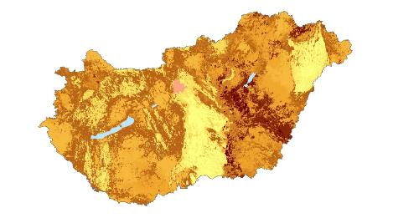
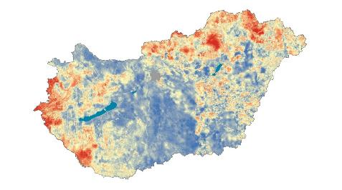
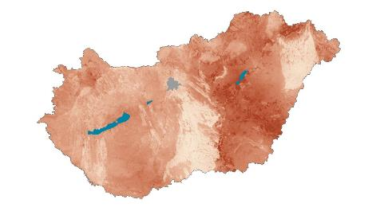
Objectives of the NAGiS – 1
Create a multipurpose geo-information system that can support the policy-making, strategy-building and decision-making process related to the impact assessment of climate change and elaborating necessary adaptation actions for Hungary.
fulfilling climate change laws, regulations and meeting policy expectations
developing a complex methodology for the analysis of climate change impacts
quantitative analysis of vulnerability for the whole chain
of impacts (exposure, sensitivity, adaptation capacity)
Providing with data for impact assessments – results for sectorial and territorial planning and adaptation strategies

Slide 5
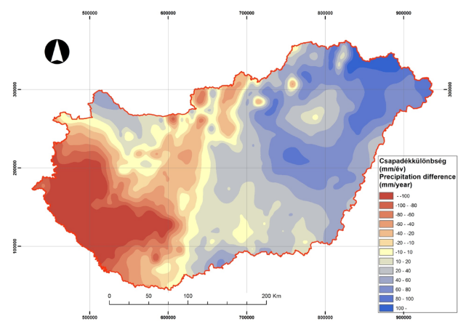
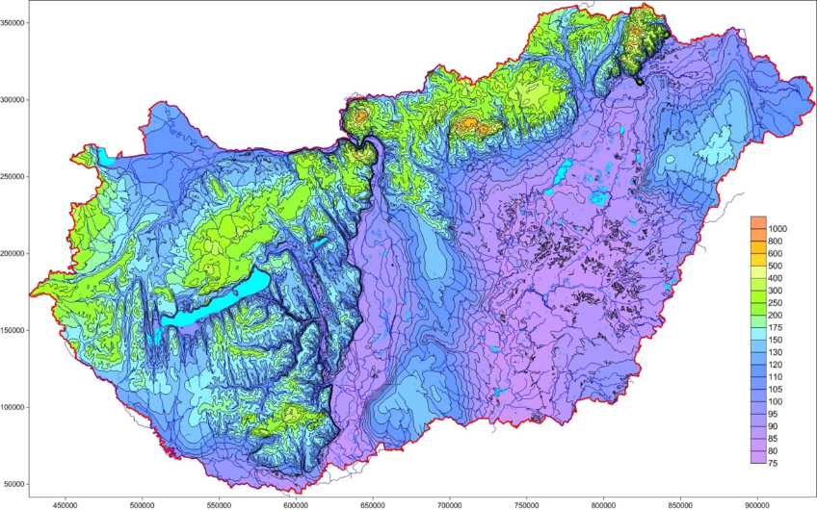
Objectives of the NAGiS – 2
Impact of climate change in the past 45 years
Difference in precipitation (2005-2009/1961-65)
up-to-date, objective information for climate change policy, territorial planning
exploring local adaptation possibilities, helping municipality level climate strategy planning and implementation
integration of data generated by governmental institutions, building a meta-database and development of a geo-information system
Creating sectoral indicators for decision-making and planning
query and visualisation systems for strengthening national, regional and local adaptation potentials
dissemination of information and knowledge, awareness raising
Groundwater tables of Hungary created by numerical modelling

Slide 6


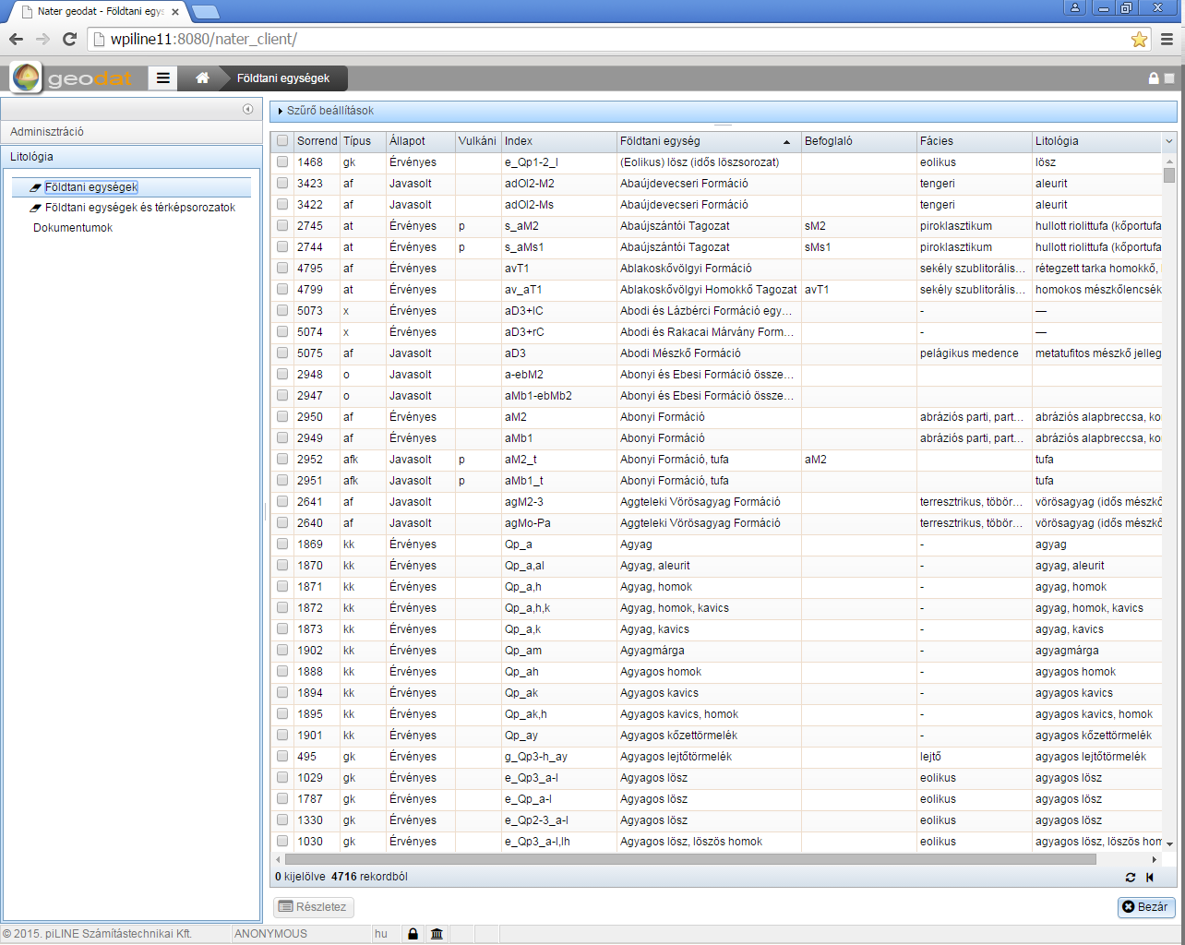
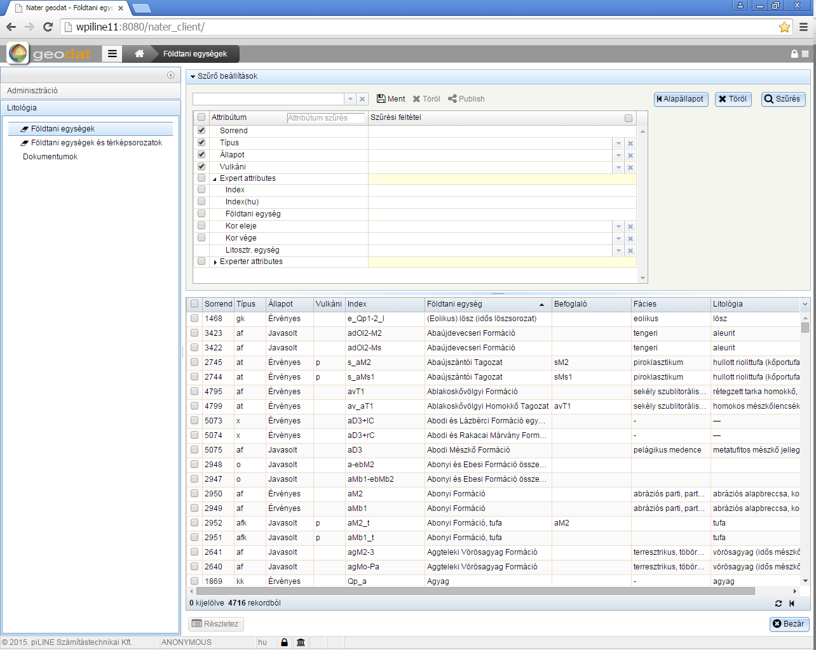
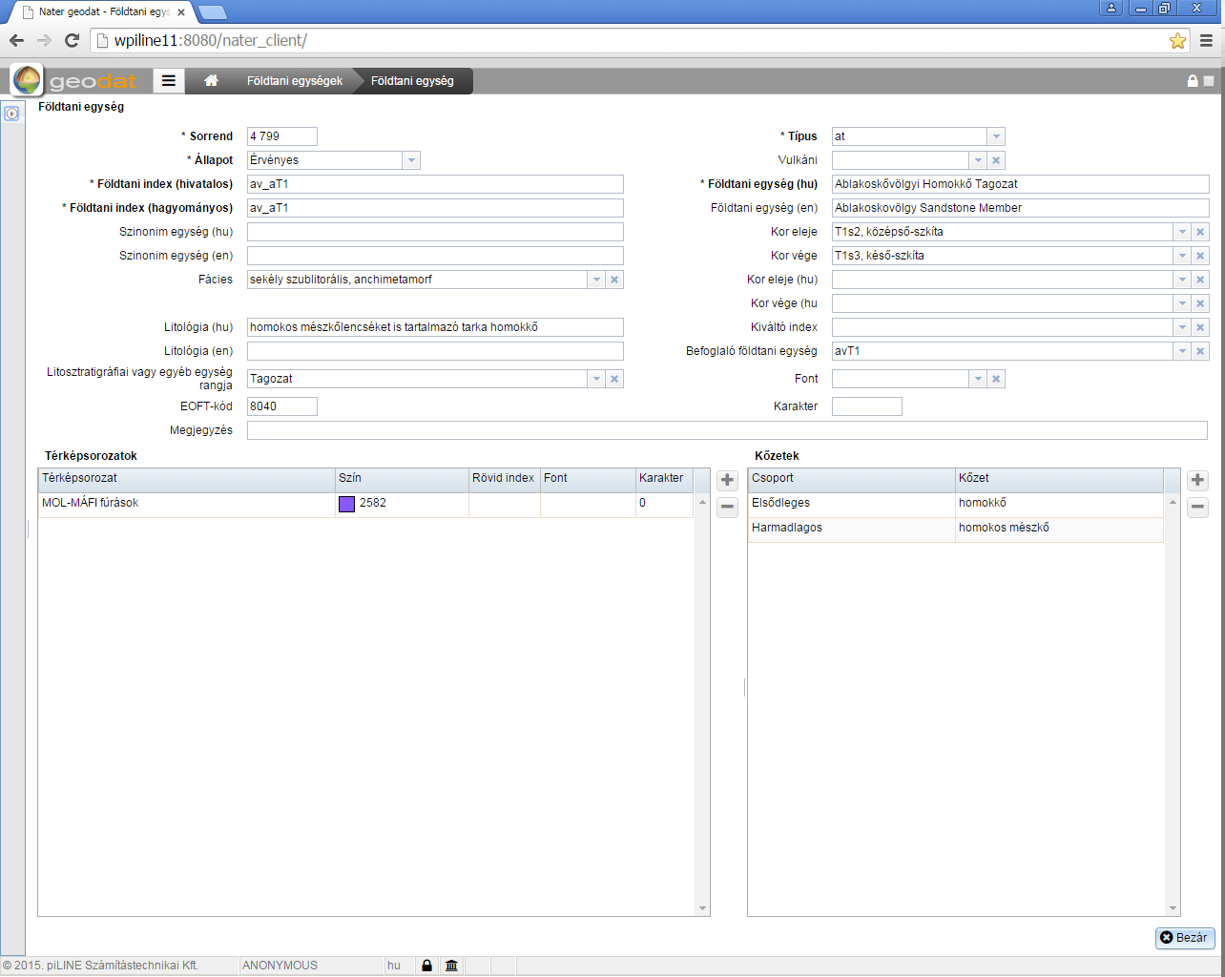
  RESULT:
  Integrated policy databases for queries
  managed by GeoDat
Task and added value:
Multifunctional, up-to-database
A flexible tool to support decision-making
Promoting policy planning
Directions of development:
An information module for policy makers
A module for making reports and for supporting preparing for daily tasks of policy -making
A module for municipalities

Slide 7


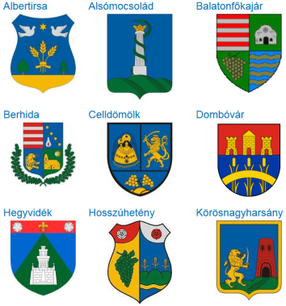







Additional data layers
KRITéR
RCMTéR
AGRATéR
arable land, forest, grassland Indicators
Excess mortality caused by extreme heath waves
Quantifying climate projections uncertainty
Model data processing for climate
földhasználat változása
Hungary's long-term social and economic development trajectory forecast
Road accidents
tourism
Development of climate model- data
impact assessments
Land use
economy
demography
Modeling socio economic processes up to 2050:
Changes in land use
effects on the agricultural sector
arable land, forests, grasslands vulnerability assessment methodology
zántó, erdő, gyep indikátorok
  decision making support
  Data layers
Local gov.
Inhabitants, general public
Economic decision makers
  Research
Universities, research institutions
  Data layers

Slide 8


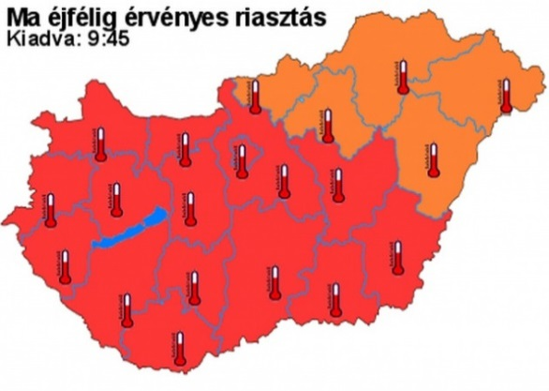
  Application possibilities of the NAGIS
  In national, local and sectoral strategical planning
Climate policy, energy policy, green industry development, agricultural and
rural development, disaster protection/control
  Supporting policies in focus, identification of intervention areas,
  supporting strategic planning
Local and regional climate strategy planning
  Climate protection strategies of settlements and
  rural areas/regions and adaptation
Touristic planning
  The impact of climate change on touristic destinations
Health and quality of life related planning
  Preparing for extreme climatic events (ex. Heath waves)

Slide 9
  Thank you for your attention!
  www.rec.org
  www.eea.rec.org
  http://nagis.hu

